Slide 1

AI/ML Applications on Gadi
- Natural Language Processing
NCI Training
Zhuochen Wu

Slide 2
Outline
Lectures
Introduction to Machine Learning and Deep Learning
Text Processing
Recurrent Neural Networks
Transformers
Topic Modeling
Notebooks
Text processing
RNN
Q&A
Topic Modeling

Slide 3
NLP – Natural Language Processing
The techniques for computer software to classify, understand and generate human language.
Applications:
Machine translation(Google Translate)
Natural language generation
Information retrieval
Spam filters
Sentiment Analysis
Chatbots
Linguistic analysation
Social science analysation

Slide 4


Machine Learning and Deep Learning
Machine learning
Deep learning
Neural networks
Matrix
Loss function
Gradient and backpropagation
SGD and learning rate
Example code
nci.org.au
4

Slide 5
Machine learning
Supervised
Unsupervised
Reinforced
Learning methods
Dataset
Algorithm
Features
Components
Numbers, text, images, speech…
Linear regression, Decision Tree, SVM……
Attributes in data
Examples
Notes:
The machine learning process is usually starting with guessing the model’s parameters (=random values). It is then trying to use the parameters to make predictions on the training examples and evaluate the differences between the model prediction and the real value (=model error). Then, it repeats the process multiple times on the numerous examples, where each time, it is changing the initial parameters to minimize this error.
Need example:
Supervised: using labelled data with guidance. Regression for continuous prediction, classification for label prediction
Unsupervised: needs more data, without labels, figure it out on its own. Finding underlying patterns. Association rule- co-occurance, clustering-based on similarity(target marketing), anomaly detection
Reinforced: no predefined dataset, giving reward or punishments. Robot moving

Slide 6
Deep learning – Neural Networks
Given input x, to predict the answer
1. y₁ = W₁*x + b₁
weight
loss
bias
2. Some non-linear magic - decides how ‘excited’ the neuron is
- to adapt to complex patterns of the problem
Activation function
labels
f₁(y₁)
answer
prediction
x
y₂ = W₂*y₁ + b₂
Input
Hidden
Output
f₂(y₂)
Partial derivatives to W_{1,} b₁
Partial derivatives to W_{2,} b₂
How did it do?
Gradient

Slide 7
Now repeat it… And more data!
Fully connected layer
x₁
.
.
.
.
.
.
Batch size = 2
x₂
iteration
x₃
epoch
x₄
.
.
.
x_{i}

Slide 8
Matrix
Element-wise multiplication
x [x_{11,} x_{12,} x_{13, …} x_{1n}]
[x_{21,} x_{22,} x_{23, …} x_{2n}]
……
[x_{i1,} x_{i2,} x_{i3, …} x_{in}]
Input feature dimension = n
[1, 2] [5, 6] [5, 12]
[3, 4] [7, 8] = [21, 32]
y = tensor * tensor
Inner product
w [w_{11,} w_{12,} w_{13, …} w_{1i}]
[w_{21,} w_{22,} w_{23, …} w_{2i}]
……
[w_{m1,} w_{n2,} w_{n3, …} w_{ni}]
1x5 +2x7 = 19
Output number = m
[1, 2] [5, 6] [19, 22]
[3, 4] [7, 8] = [43, 50]
tensor2 = tensor.matmul(tensor1)
b [b₁, b₂, b_{3,} …b_{n}]
Matrix shape
Broadcasting to mxn
A_{nxm} B_{mxh} = C_{nxh}
C_{nxh} → C^{T} _{hxn}

Slide 9
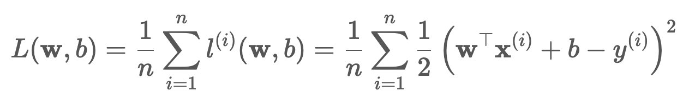
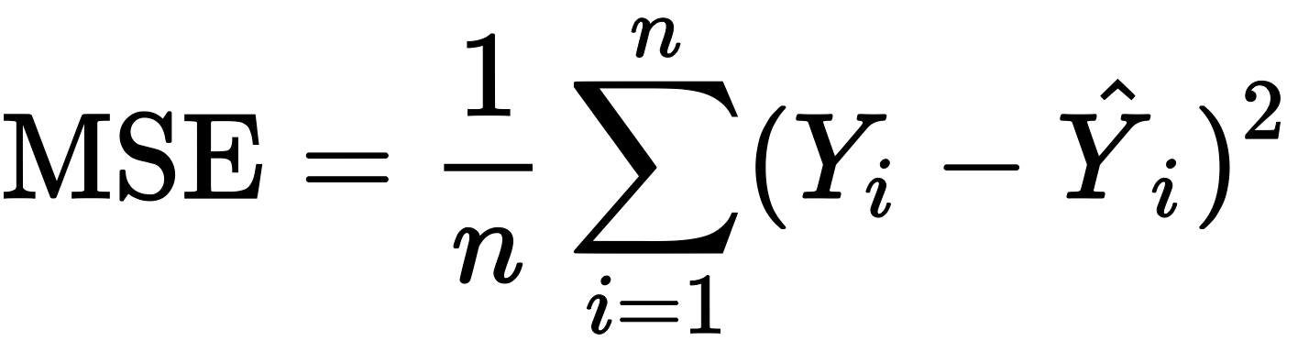
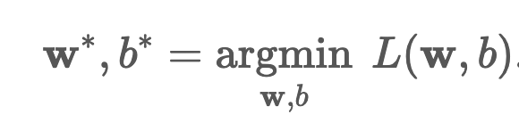
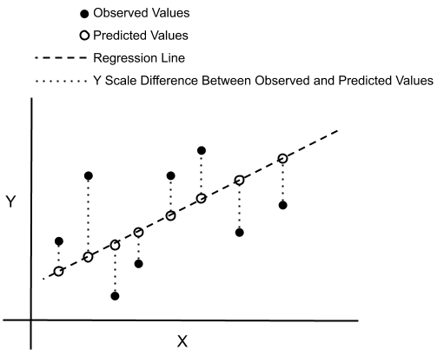
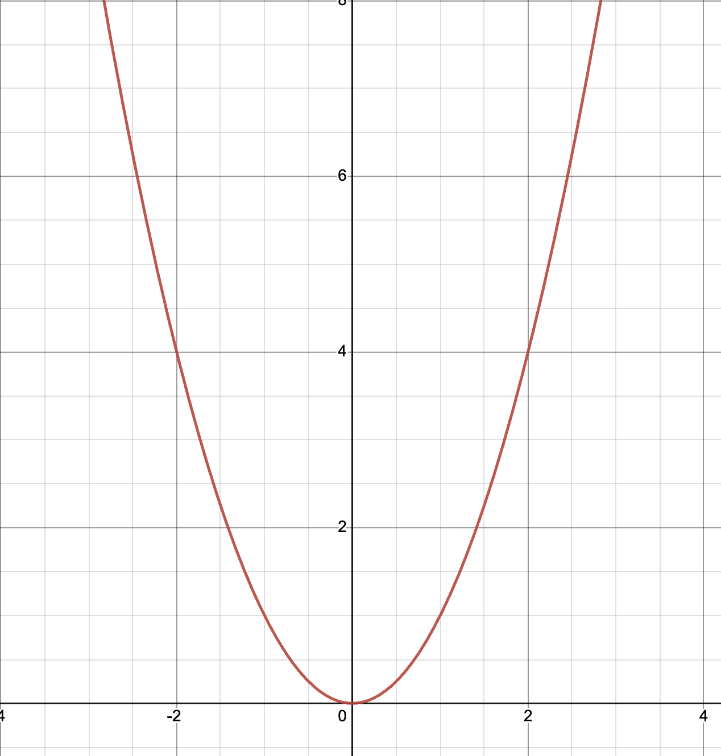
Loss function
Predicted value
Example: Mean Square Error
Training goal:
Y = x²
Y’ = 2x
Derivative -> value change direction
Notes:
MSE for continuous output range
Cross entropy for classification with softmax

Slide 10
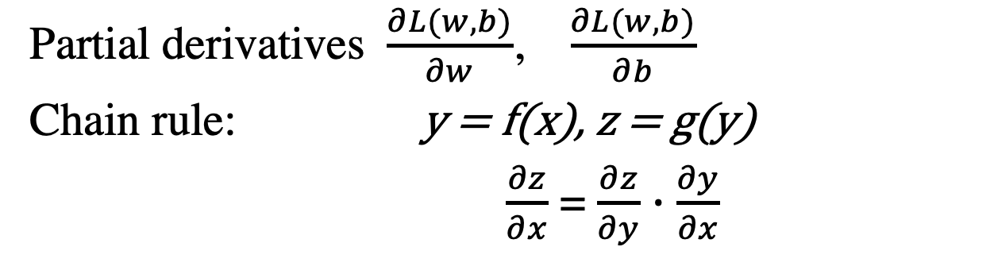
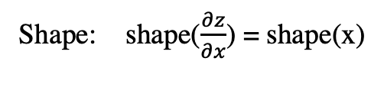
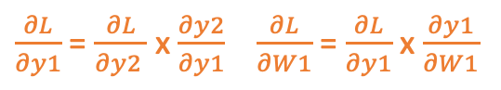
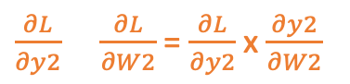
Gradient and Backpropagation
Partial derivatives $\frac{∂L(w, b)}{∂w}$, $\frac{∂L(w, b)}{∂b}$
Chain rule: y = f(x), z = g(y)
$\frac{∂z}{∂x}$ = $\frac{∂z}{∂y}$ $∙$ $\frac{∂y}{∂x}$
Shape: shape($\frac{∂z}{∂x}$) = shape(x)
Back propagation:
From loss function to input direction.
Store value for each step for quick read;
Using the parameters from forwarding
Shape(m, x)
Shape(m, 1)
Shape(n, m)
Shape(n, 1)
shape(x,1)
y2 = g(y₁)
y1 = f(x)
x
y1 = w1 x+b
Hidden
y₂ = W₂*y₁ + b₂
Output
L
$\frac{∂L}{∂y2}$ $\frac{∂L}{∂W2}$ = $\frac{∂L}{∂y2}$ x $\frac{∂y2}{∂W2}$
$\frac{∂L}{∂y1}$ = $\frac{∂L}{∂y2 }$ x $\frac{∂y2}{∂y1}$ $\frac{∂L}{∂W1}$ = $\frac{∂L}{∂y1}$ x $\frac{∂y1}{∂W1}$
Shape(n, 1), shape(n, m) = shape(n,1) . Shape(m, 1)
y₁^{T}
Shape(m, 1) = shape(n, 1) x shape(n, m), shape(m, x) = shape(m, 1) x shape(x, 1)

Slide 11
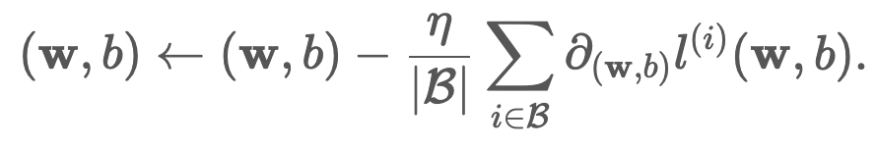
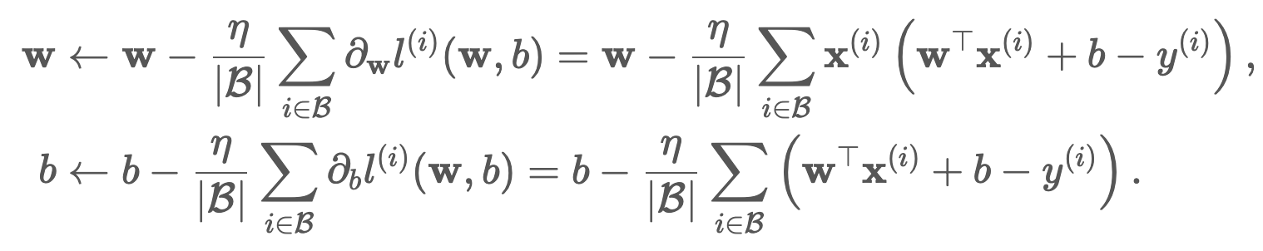
Stochastic Gradient Descent and Learning Rate
L = w²
gradient
η learning rate
B mini-batch size
Optimizer
Notes:
Eta - lr

Slide 12
Training Process – from scratch
# Initialize parameters
w = torch.normal(0, 0.01, size=(2,1), requires_grad=True)
b = torch.zeros(1, requires_grad=True)
# Define the model:
def linreg(X, w, b):
return torch.matmul(X, w) + b
# Define loss function:
def squared_loss(y_hat, y):
return (y_hat - y.reshape(y_hat.shape)) ** 2 / 2
# Define optimizer
def sgd(params, lr, batch_size):
with torch.no_grad():
for param in params:
param -= lr * param.grad / batch_size
param.grad.zero_()

Slide 13
Training Process (Cont.)
# hyperparameters
lr = 0.03
num_epochs = 3
net = linreg
loss = squared_loss
# train the model
for epoch in range(num_epochs):
for X, y in data_iter(batch_size, features, labels):
l = loss(net(X, w, b), y)
l.sum().backward()
sgd([w, b], lr, batch_size)
with torch.no_grad():
train_l = loss(net(features, w, b), labels)

Slide 14
Text Processing
Text cleaning
Co-occurance
Word2vec
CBOW
nci.org.au
14

Slide 15
Data Cleaning
Tokenisation
Stopwords Removal
Lemmatization/Stemming
Data structure
Data source
Common dirty strings:
HTML tags
Human typos
Data encoding
Punctuations
"<b>A touching movie!!\n</b> It is full of emotions and wonderful acting\n\n\n.<br> I could have sat through it a second time.”
“A touching movie It is full of emotions and wonderful acting I could have sat through it a second time”
Python string functions
Regular expression – Regex

Slide 16
Data Cleaning
Tokenisation
Stopwords Removal
Lemmatization.Stemming
“A touching movie It is full of emotions and wonderful acting I could have sat through it a second time”
[“a”, “touching”, “movie”, “it”, "is”, “full”, “of”, “emotions”, “and”, “wonderful”, “acting”, “I”, “could”, “have”, “sat”, “through”, “it”, “a”, “second”, “time”]
Python string functions
Libraries: Nltk, WordNet, Spacy …

Slide 17
Data Cleaning
Tokenisation
Stopwords Removal
Lemmatization/Stemming
[“a”, “touching”, “movie”, “it”, "is”, “full”, “of”, “emotions”, “and”, “wonderful”, “acting”, “I”, “could”, “have”, “sat”, “through”, “it”, “a”, “second”, “time”]
[“touching”, “movie”, “full”, “emotions”, “wonderful”, “acting”, “have”, “sat”, “second”, “time”]
Python string functions (customization)
Libraries: Nltk, WordNet, Spacy …

Slide 18
Data Cleaning
Tokenisation
Stopwords Removal
Lemmatization/Stemming
[“touching”, “movie”, “full”, “emotions”, “wonderful”, “acting”, “have”, “sat”, “second”, “time”]
[“touching”, “movie”, “full”, “emotions”, “wonderful”, “acting”, “have”, “sait”, “second”, “time”]
[“touching”, “movie”, “full”, “emotions”, “wonderful”, “acting”, “have”, “sait”, “second”, “time”]
Libraries: Nltk, WordNet, Spacy …

Slide 19
How to represent words so that computer can understand?
“stand on his head”
“easily”
Thesaurus
Co-occurrence
word2vec
CBOW
motorcar
car
auto
automobile
Notes:
Cons:
- thesaurus:
can’t keep up the change of language;
expensive manpower
can’t distinguish the nuance difference between words

Slide 20
Co-occurrence
Window size
[“I”, “eat”, ‘burger”, “and”, “you”, “eat”, “salad”]
[1, 2, 3, 4, 5, 2, 6]
{“I”:1, “eat”:2, “burger”:3, “and”:4, “you”:5, “salad”: 6}
Corpus
word_to_id
id_to_word
Represent the words
Keep the context
Window size = 1
Vocabulary

Slide 21
Co-occurrence Matrix
 | I | eat | burger | and | you | salad
burger | 0 | 1 | 0 | 1 | 0 | 0
Unique words
Co-occurrence count
I [0, 1, 0, 0, 0, 0]
Eat [1, 0, 1, 0, 1, 1]
Burger [0, 1, 0, 1, 0, 0]
And [0, 0, 1, 0, 1, 0]
You [0, 1, 0, 1, 0, 0]
Salad [0, 1, 0, 0, 0, 0]
Vector for “burger” = [0, 1, 0, 1, 0, 0, 0]
Repeat for all words in our sentence …
Notes:
Cons:
- stop words have high frequency:
Positive Point-wise Mutual Information (PPMI matrix, considering the stopwords individual probability of occurrence)
- huge matrix dimensions for large vocabulary size:
Dimensionality Reduction to shorter, denser vectors

Slide 22
Word2vec – a prediction problem
[“I”, “eat”, ‘???”, “and”, “you”, “eat”, “salad”]
Probability distribution
Context:
“eat”
“and”
Model
One-hot vector:
ID | Word | I | eat | burger | and | you | salad
2 | eat | 0 | 1 | 0 | 0 | 0 | 0

Slide 23
Word2vec
CBOW
Skip-gram
One-hot vector
I | 0
eat | 1
burger | 0
and | 0
you | 0
salad | 0
eat
eat
One-hot vector
x Weight_in
I | 0
eat | 0
burger | 1
and | 0
you | 0
salad | 0
x Weight_out
Score
burger
mean
mean
x Weight_out
x Weight_in
and
and
x Weight_in
Output layer
x Weight_out
Hidden layer
Input layer

Slide 24
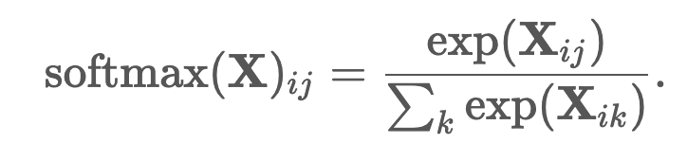
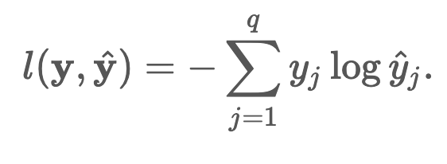
CBOW Learning Process
Binary classification
One-hot vectors
Embedding
Burger
Yes/No ?
Softmax – get probability
I | 0
eat | 1
burger | 0
and | 0
you | 0
salad | 0
eat
Score
Prob
Loss function
x Weight_in
mean
softmax
Cross entropy error
x Weight_out
loss
I | 0
eat | 0
burger | 0
and | 1
you | 0
salad | 0
and
x Weight_in
label
answer
Cross-entropy loss
Hidden layer
Output layer
I | 0
eat | 0
burger | 1
and | 0
you | 0
salad | 0
Input layer
[[0 1 0 0 0 0]
[0 0 0 1 0 0]]
Notes:
Computational challenge: when input vocab is large, the compute of weight matrix and loss are huge.
Improvement: Embedding – get index of weight_in matrix, reduce weight_in size
Binary classification – reduce weight_out matrix size
- reduce computation on loss, change loss function to Sigmoid

Slide 25
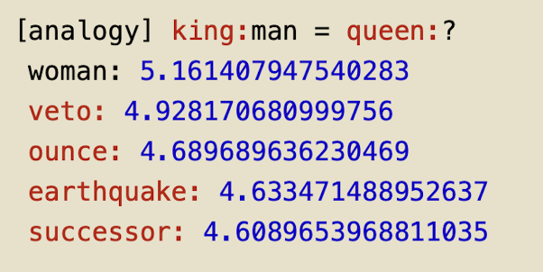
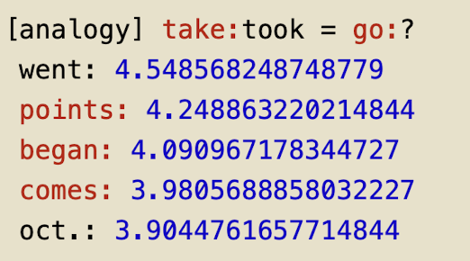
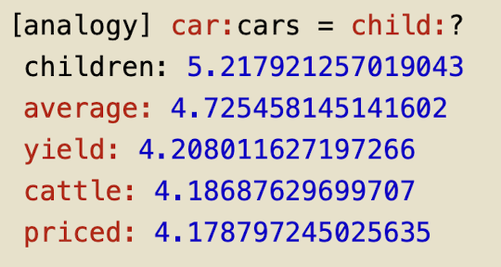
CBOW Result – Distributional Representation
Weight_in matrix to represent words meaning
Syntax – plurals, past tenses…
Semantics
“king – men + women = queen”
Notes:
Transfer learning: - not learning distributional representation from scratch
- Use big corpus to study first, like Wikipedia, Google, News…
- then use the distributional representation for tasks, like text classification, clustering, sentiment analysis…
Problem: can’t remember long previous context, ignore the order of input sequence
Solution: RNN, LSTM

Slide 26
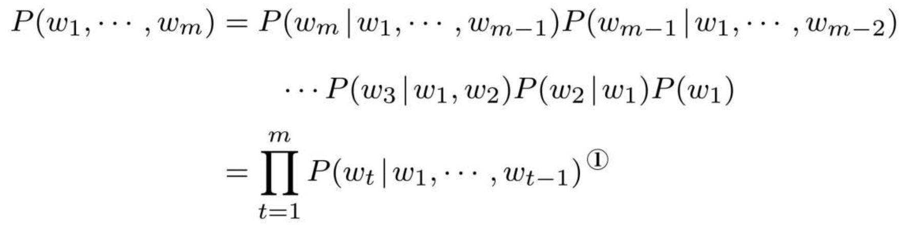
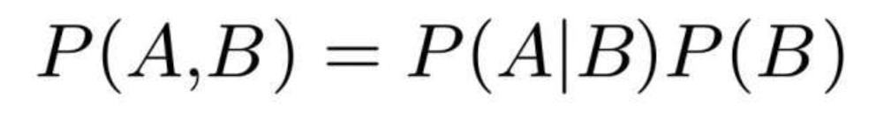
Language Model
Language model: the probability of a sequence of words.

Slide 27
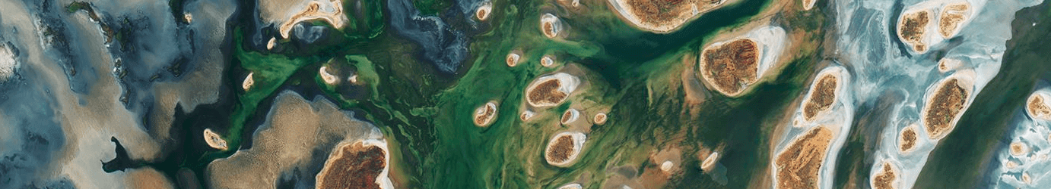
Code – Notebook 1
nci.org.au

Slide 28
Recurrent Neural Networks
Simple RNN
LSTM
Seq2seq
Attention
Transformer
nci.org.au
28

Slide 29
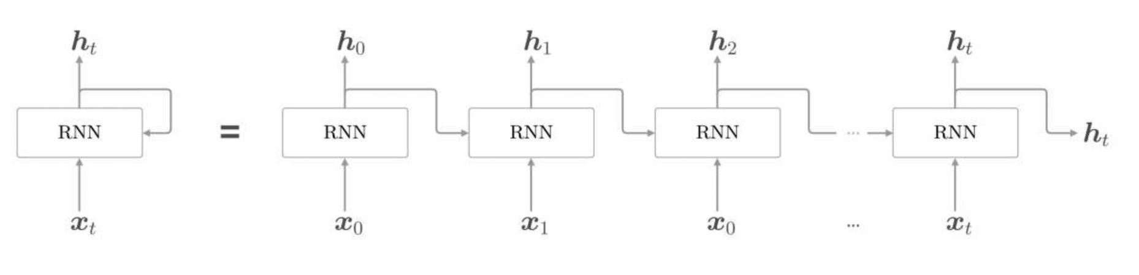
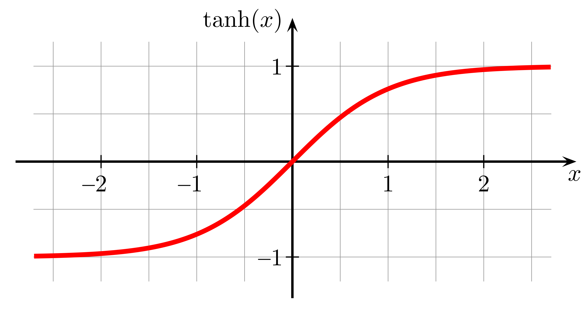
Simple RNN
Hidden state
Truncated BPTT – Truncated Backpropagation Through Time
h_{t} = tanh(h_{t-1}W_{h} + x_{t}W_{x} + b)
Output = W_{h}*h_{t}
Notes:
Truncated BPTT: adapt for big computation costs; prevent gradient disappearing
Truncating and minibatch: for seq with length 1000, truncating with 10 time-steps, and 2 batches, we have batches = [[x0-x9], [x500-x509]]

Slide 30
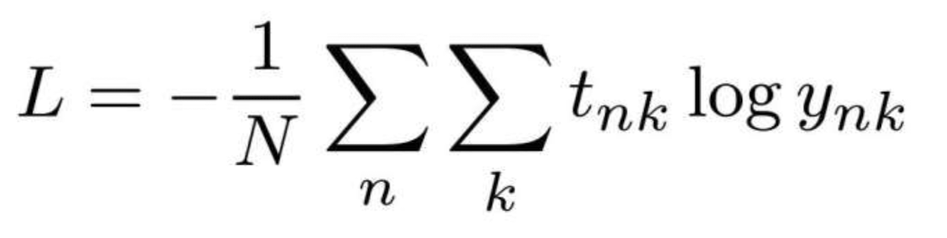
Simple RNN
y_{t}
Softmax with Loss
t₀
Softmax with Loss
t₁
Softmax with Loss
t_{T}
…
…
…
…
h_{t}
Perplexity = e^{L}
RNN
RNN
RNN
Perplexity: the number of possible candidates
Embedding
Embedding
Embedding
word₀
word₁
word_{T}
Notes:
Deep: multiple RNN layers
Problem: gradient disappearing (tanh)/ exploding grandients (same Wh matrix being multiplied many times, disappearing if Wh <0, exploding if Wh >0 )
Solution: change tanh to RELU, use gradients clipping (if gradient's l2 norm bigger than a threshold, gradiant = threshold/l2 norm), LSTM

Slide 31
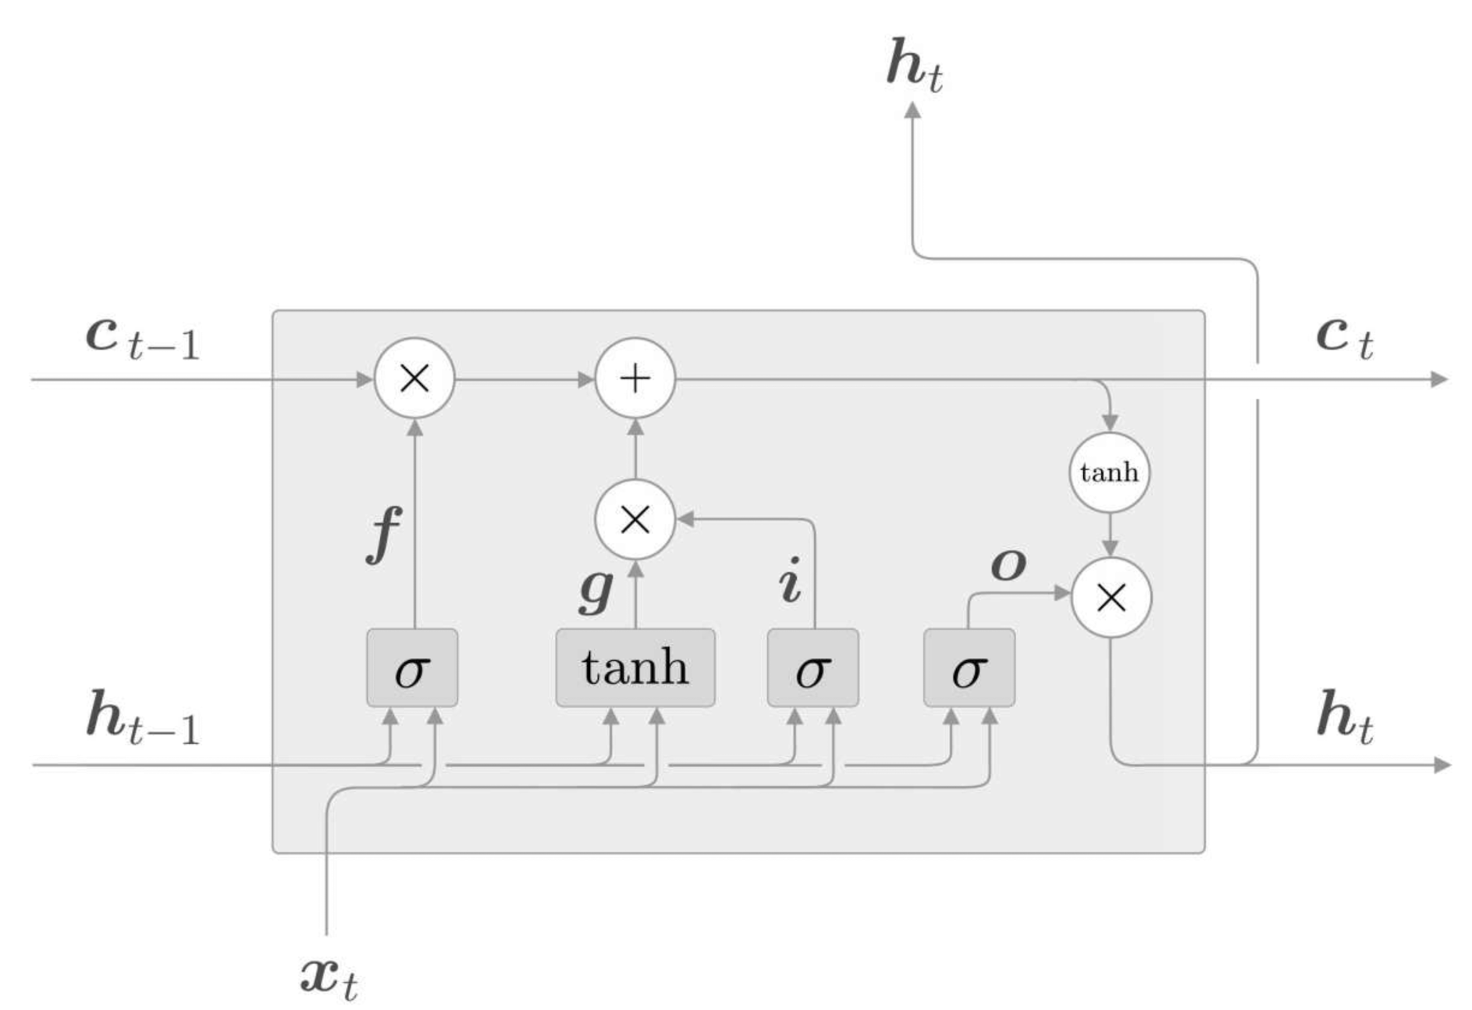
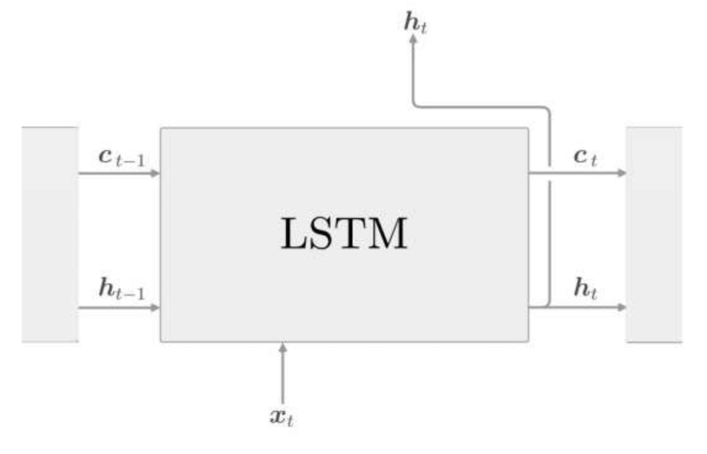
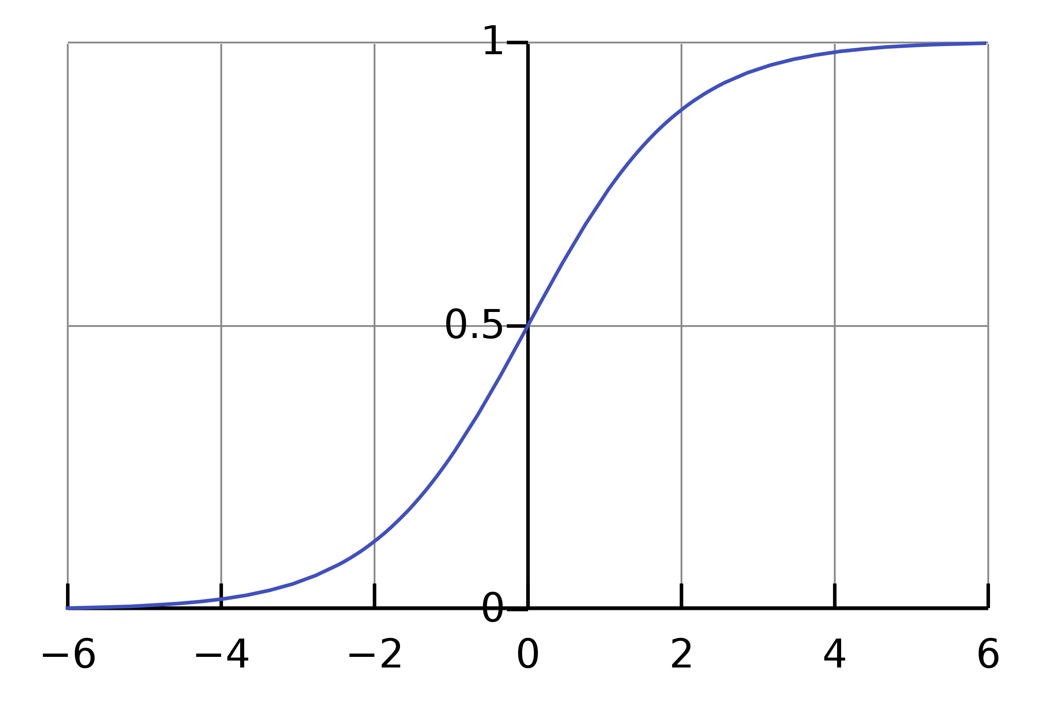
LSTM – Long Short-Term Memory (Gated RNN)
Controls gates
Sigmoid(x)
Tanh(x)
Notes:
There are different designs for the LSTM gates, this example is classic one
Usually use sigmoid for gates, tanh for actual information

Slide 32
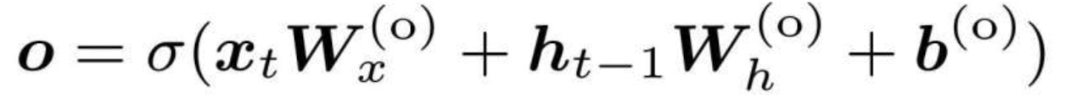
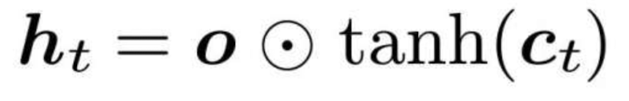
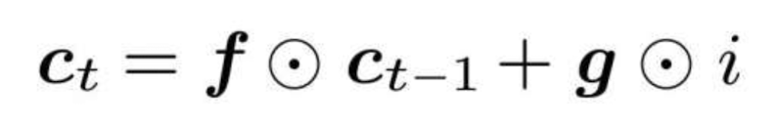
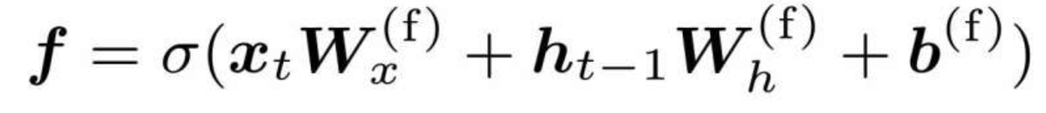
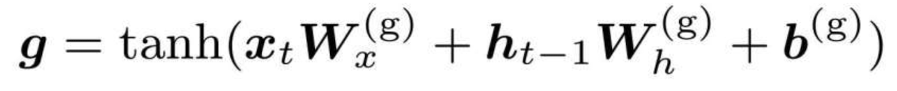
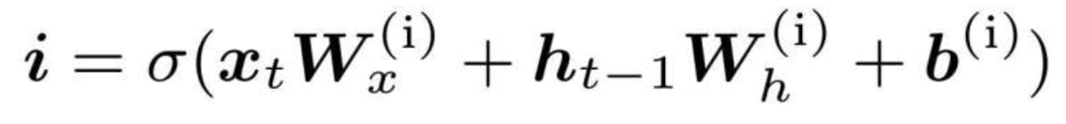
LSTM – Long Short-Term Memory (Gated RNN)
Element-wise multiplication
Output gate
Forget gate
Memory gain
Input gate
Notes:
Why it resolves gradient disappearing: the multiplication keeps the gradient the same during backpropagation;
Why it resolves gradient exploding: element-wise multiplication instead of MatMul, also Weights for gate functions are different for each time step
Disadvantage: Various length of input, but a fixed-length of output
Solution: Seq to Seq

Slide 33
Seq2Seq Model
output
Decoder
Applications:
Translation
Chat bot
Summarization
Image to caption
Encoder
Softmax with Loss
Affine
LSTM
h_{T}
h_{T} - the last row of hidden state
LSTM
Embedding
Embedding
Time direction repetition
sequence
labels
Notes:
Encoder: transform any length text to a fixed length vector by padding the vector length
Output final hidden state information as input to decoder
Can be bi-directional RNN
Disadvantages: fixed length encoder
return h for each word input, so we get same h as input sequence. Each h includes words information before current word

Slide 34
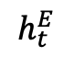
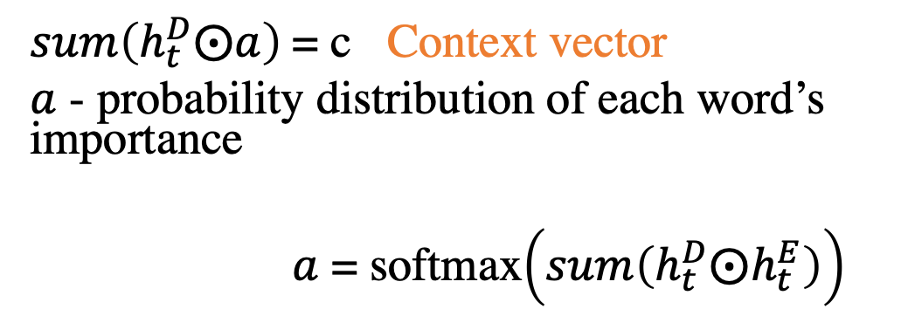
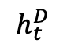
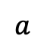
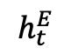
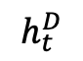
Attention in Seq2Seq
Weight sum
Softmax with Loss
$sum\left(h_{t}^{D}⨀a\right)$= c Context vector
$a$ - probability distribution of each word’s importance
$a$ = softmax$\left(sum\left(h_{t}^{D}⨀h_{t}^{E}\right)\right)$
Affine
Attention weight
$$h_{t}^{D}$$
Attention
c
$$h_{t}^{E}$$
Weight Sum
LSTM
h_{T}
LSTM
$$h_{t}^{D}$$
e.g. vector similarity, here we use dot product
$$a$$
Embedding
Attention Weight
Embedding
$$h_{t}^{E}$$
Encoder
Decoder
Attention
Notes:
Translation alignment: cat = 猫
Attention：automatic alignment
Selecting corresponding word information from ht in each time state by calculating word importance (a) in ht
There are other designs of attention function and models with attention module, it can feed forward to next LSTM time step instead of Affine
Deep: multiple LSTM with one Attention, or multiple Attention as well. Need to use dropout, gradient clipping, skip connection(skip layers by element wise addition, for depth direction gradient disappearing) or other ways to avoid overfitting

Slide 35
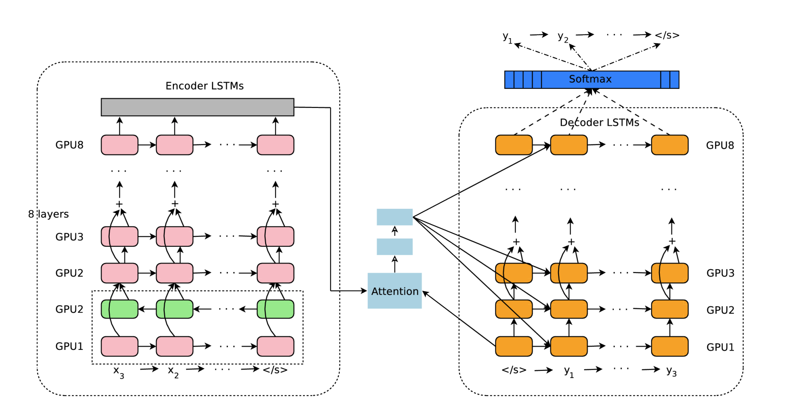
Example. Google Neural Machine Translation
Wu, Yonghui, et al. Google's neural machine translation system:Bridging the gap between human and machine translation[J]. arXiv preprint arXiv:1609.08144, 2016.
Notes:
RNN disadvantage: sequential input, so no parallel processing
Solution: transformer

Slide 36
Code – Notebook 2
nci.org.au

Slide 37
Transformers
Transformer
GPT
Bert
nci.org.au
37

Slide 38
Transformer – Attention without RNN
Affine
Softmax with Loss
Self-attention instead of LSTM layer
Multi-head attention
Feed Forward
Loss
Feed Forward
Attention
Attention
Attention
Embedding
Embedding
Depth repetition
Encoder
Decoder
Notes:
With self attention first, normal attention in decoder later
Will have extra process like masking with seq length, positional encoding, layer normalization etc

Slide 39
Bert – NLP Model Based on Fine Tuning!
Bert – transformer without decoder
Pre-trained model has extracted enough features
Only need to replace output layer for a new task
Original models in the paper:
Base: 12 (transformer encoder) blocks, hidden size = 768, 12 heads, 110M parameters
Large: 24 blocks, hidden size = 1024, 16 heads, 340M parameters
Trained on more than 3B words (whole Wikipedia and some books)

Slide 40
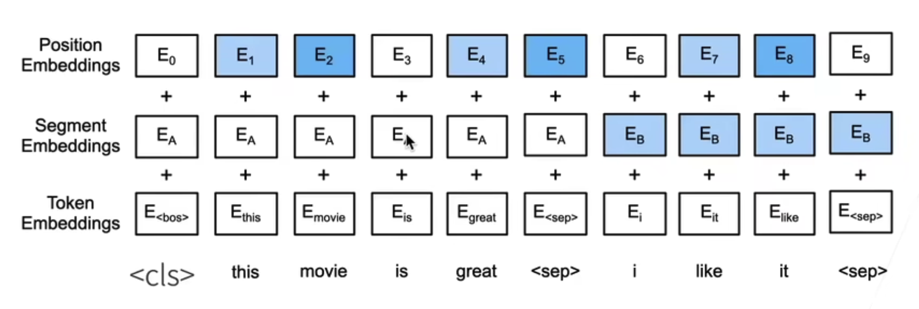
Bert
Pretraining:
Masked language model - randomly mask some words in the sentence to predict
Predict next sentence – 50% chance to select adjacent sentences as paired input, 50% chance to select random sentence pairs. Predict <cls> in output
Paired sentence input
Additional special tokens
Trainable position embedding

Slide 41
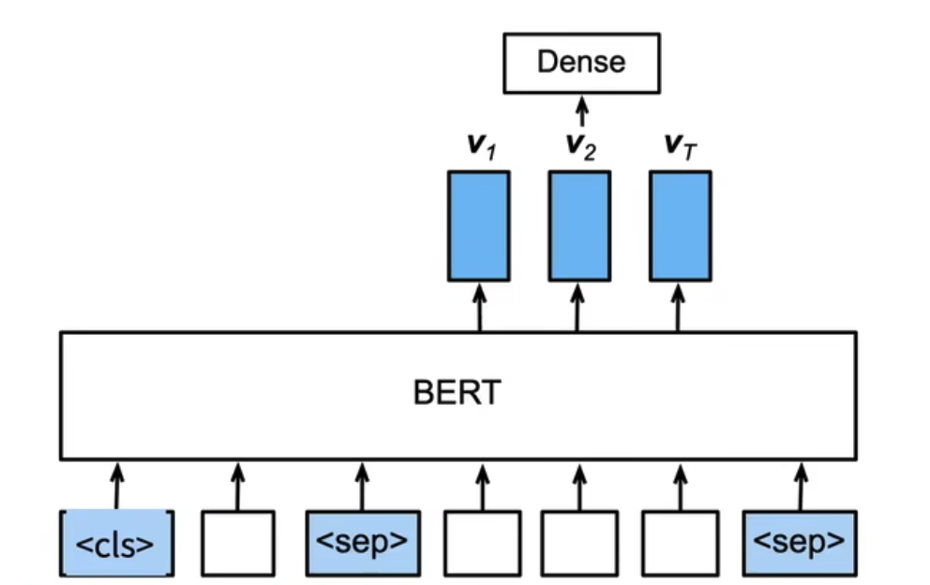
Bert – Q&A
Output:
Token is the start of the answer
Token is the end of the answer
Neither
Fine tuning:
Increase the learning rate for output layer
Set some of the base layer parameters so finish training faster
Question
Paragraph
Notes:
Custom labeled dataset for Q&A tuning

Slide 42
Code – Notebook 3
nci.org.au

Slide 43
Topic Modeling
K-means
LDA
Tf-idf
nci.org.au
43

Slide 44
K-means Clustering
One document → one topic
Set K – number of clusters
Randomly assign k points as the centroid of the clusers
Measure distance between point a and the k clusters
Assign point a to the cluster with the minimum distance
Repeat 3-4 for all data points
Recalculate the cluster centroid
Repeat 5-6 until the clusters don’t change anymore
Calculate total clusters variance
Repeat 2-8 N times, result is the clustering with the minimum variance

Slide 45
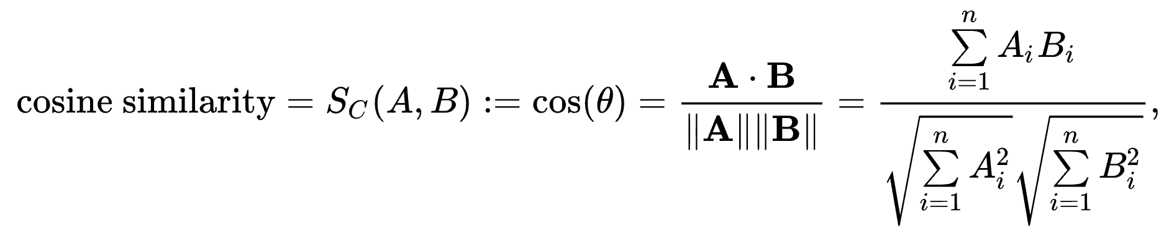
Similarities in Text Vectors

Slide 46

LDA – Latent Dirichlet Allocation
Doc 1
Doc 2
Doc 3
Doc 4
Dog
dog
Toy
Owner
Galaxy
planet
track
Galaxy
Galaxy
planet
green
government
companies
change
planet
earth
CO2
environment
change
0.74
0.10
0.16
$$α$$
Documents-Topics Distribution
pet
science
society

Slide 47

LDA – Latent Dirichlet Allocation
pet
science
society
$$β$$
Topics-Words Distribution
Word 1
Word 2
Word 3
Word 4
Dog
Owner
government
planet
Goal:
1. each document has a main topic
2. Each word has a main topic
Notes:
Starting with random assignment, increase each word with the most possible topic at the moment

Slide 48
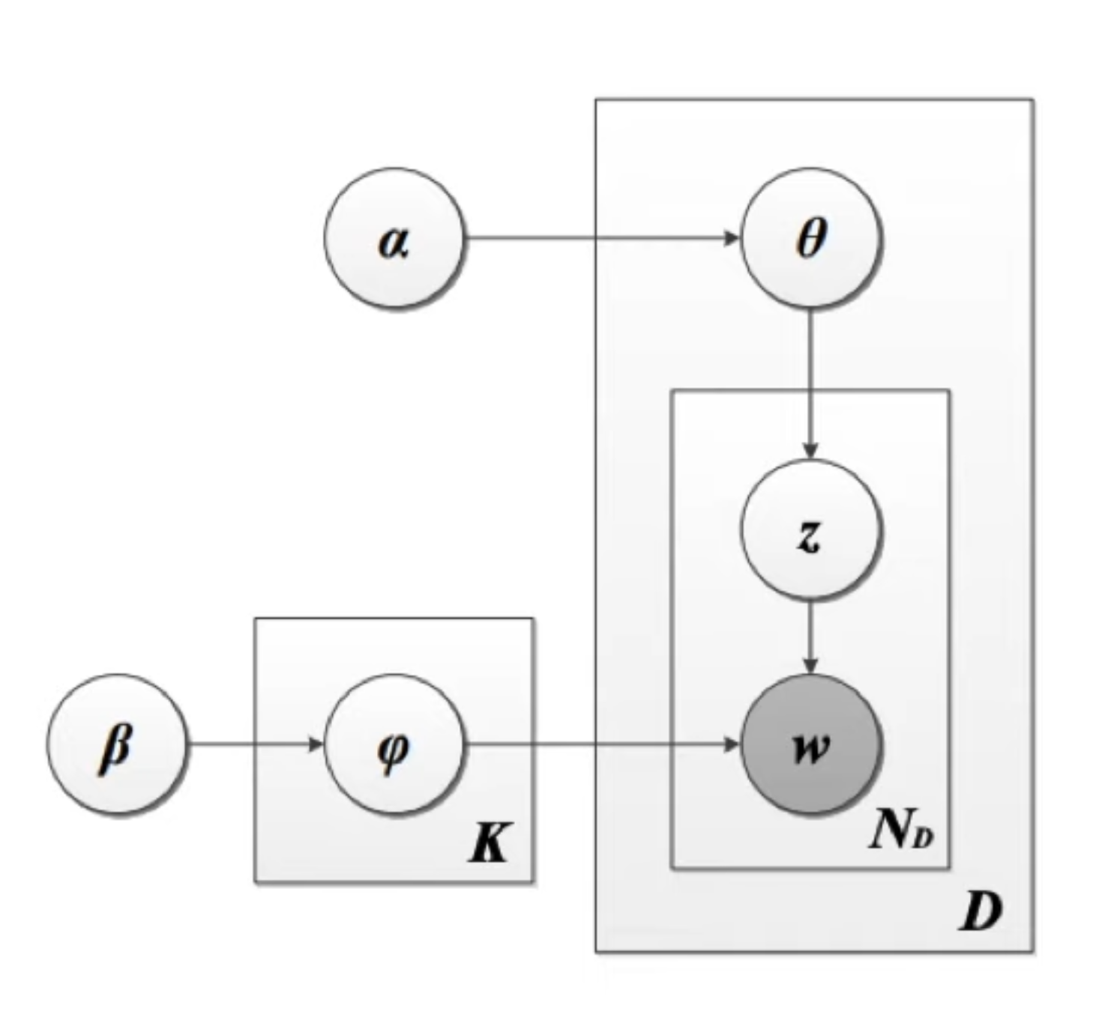
LDA – Latent Dirichlet Allocation
Dirichlet
Docs-topics distribution
Multinomial distribution – selecting a word from a document and it has the topic t
Chosen topics
Dirichlet
Topics-words distribution
Goal:
1. each document has a main topic
2. Each word has a main topic
→ create a document as close to input document as possible
Chosen words
Multinomial distribution –
Selecting a word from a topic and it is the word w
https://www.youtube.com/watch?v=T05t-SqKArY&list=TLPQMjQxMDIwMjLirqQmTCjo-w&index=1

Slide 49
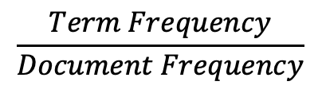
tf-idf – Term Frequency-Inversed Document Frequency
Term frequency – how often a word occurs in a document
Document frequency – how often a word occurs in the corpus
$$\frac{Term Frequency}{Document Frequency}$$
Relevance/importance/uniqueness of a word to a document
Assumes a document as a “bag of words”

Slide 50
Dimensionality Reduction
How to decide topic/cluster number?
Plot performances for different number of topics and find the ‘elbow point’
t-SNE – projecting highD data to lower dimension with cluster information
PCA
Notes:
t-SNE: Measure distance between point p and other points
Plot the distance to a normal distribution with p at the centre
Scale the value on normal distribution so that they sum up to 1
Randomly project data to lower dimensions
Repeat above steps 2-3 with t-distribution and move data points until the similarity is close to the one from original data

Slide 51
Code – Notebook 4
nci.org.au

Slide 52
References
Deep Learning from Scratch 2 © 2018 Koki Saitoh, O' Reilly Japan, Inc.
Wu, Yonghui, et al. Google's neural machine translation system:Bridging the gap between human and machine translation[J]. arXiv preprint arXiv:1609.08144, 2016.
https://www.youtube.com/watch?v=T05t-SqKArY&list=TLPQMjQxMDIwMjLirqQmTCjo-w&index=1
https://www.youtube.com/watch?v=6ArSys5qHAU

Slide 53

Questions ?
nci.org.au
53

Slide 54

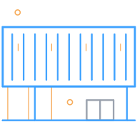




NCI Contacts
General enquiries: +61 2 6125 9800
Media enquiries: +61 2 6125 4389
Support: help@nci.org.au
Email: zhuochen.wu@anu.edu.au
Address
NCI, ANU Building 143
143 Ward Road
The Australian National University
Canberra ACT 2601
License

